Slide 1
Using abstraction to provide unbounded proofs with CBMC
Intern: Lefan Zhang (lefanz@)
Manager: Mike Whalen (mww@)
Mentor: Mark Tuttle (mrtuttle@)
September 1, 2021
Notes:
Hi everyone, thanks for coming to my end-of-internship talk. I’m Lefan Zhang, a fifth year PhD student from the University of Chicago. This summer I’m doing an internship at Amazon’s automated reasoning group. My topic is using abstraction to provide unbounded proofs with CBMC.

Slide 2
In short…
Goal: Unbounded proofs
CBMC does not support it “out of the box”.
During my internship:
Replication Reducing Abstraction (RRA):
Proves programs unboundedly with CBMC
Handles loops over arrays
Automated: no code contracts
Proved to be sound!
Notes:
Before going into any details, I’ll provide a short summary of my internship project. When we are doing proofs we really want it to be unbounded, which means that the proof should apply to input data of any size. C Bounded Model checker, or CBMC is heavily used within the group to prove C programs. As its name suggests, it doesn’t support unbounded proofs out of the box. We may miss errors that only occur in large inputs.
During my internship, I developed a tool that can help CBMC to prove programs unboundedly. It aims to handle programs with loops over arrays. The proof is automated, which means that users won’t need to write any contracts such as loop invariants. Moreover, we have also proved the tool is sound so that we can trust it.

Slide 3
Intuition of replication reducing abstraction (RRA)
Notes:
First, I’ll introduce the intuition behind the tool. The idea is called replication reducing abstraction. Later, I’ll refer to the technique as RRA.

Slide 4
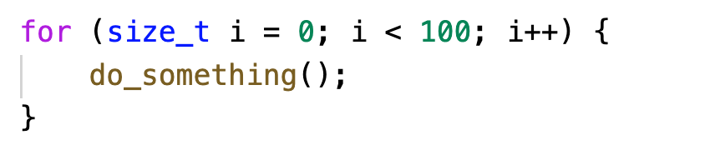
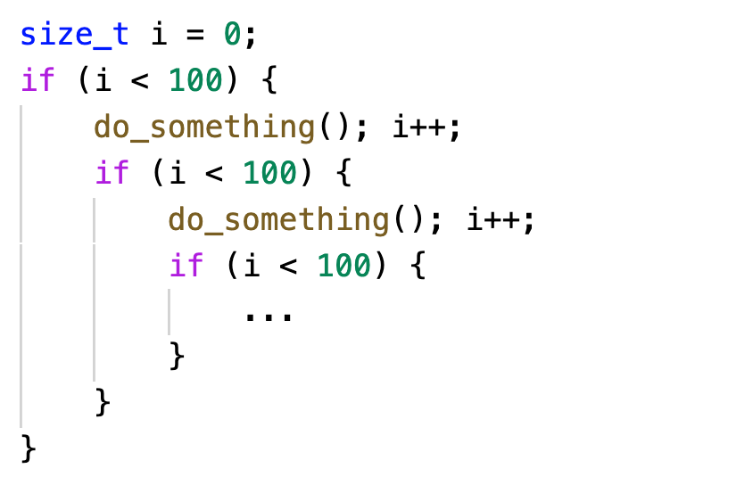
Intuition of replication reducing abstraction (RRA)
Baseline CBMC translation of repeated entities
Loops must be bounded
Errors only in “large” inputs might be lost
Often, we don’t need to handle every
Entry in arrays
Iteration in loops
CBMC unwinds loops
array:
iteration:
…
Formulas quickly get large as size increases!
Notes:
Let’s first talk about why the baseline CBMC doesn’t support unbounded input. CBMC translate the program behavior at any given step into a formula that can be checked by SAT solvers.
When it comes to loops, it has to fully unwind them. As the size of input increases, the formula becomes large very quickly. The proving time can quickly get extremely long in this case.
Therefore, loops must be bounded. As a result, errors that only appear in “large” inputs might be lost.
However, it is likely that the behavior to be proved is not related to every entries in arrays and every iterations in loops. This gives us an opportunity to not model everything precisely.

Slide 5
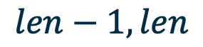
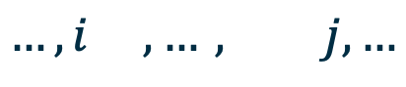
Intuition of replication reducing abstraction (RRA)
We only care about a small number of locations for each property.
Property : no memory overflow
$$len−1,len$$
array:
iteration:
…
…
Property : the array is sorted ($∀i,j<len, i<j→a\left[i\right]<a[j]$)
$$…,i ,…, j,…$$
array:
iteration:
…
…
…
Notes:
For each property, we actually only care about a small number of locations in the array.
For example, if we want to check whether there’s memory overflow, we probably only care about the last entry in the array and the entry right after it. We only want to know whether the program will write anything to these entries.
In another example, we want to check whether the array is sorted. We want to know that for any i and j that are smaller than the length, the values are sorted. Although we don’t know what is I and j beforehand, we can guess them as two free variables. Then we only care about entries at I and j.
Besides those locations we care, we can abstract the behavior in others.

Slide 6

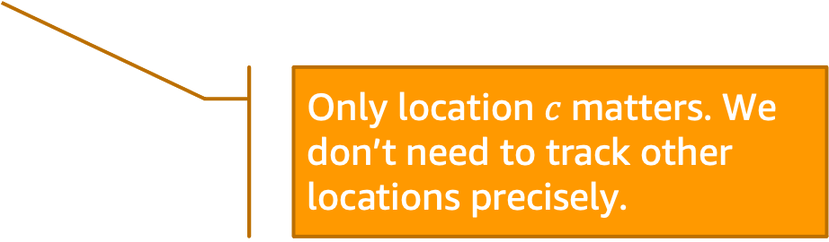
Intuition of replication reducing abstraction (RRA)
$$…,c−1,c,c+1,…$$
array:
iteration:
…
…
array:
Only location $c$matters. We don’t need to track other locations precisely.
iteration:
At abstract location : we don’t care about what happens
At precise location : we precisely handle everything
With such abstraction, the original program’s behavior is modeled with arrays/loops of small sizes
Notes:
Say that we only care about one location, c. We only need to precisely model this single location and iteration, while abstracting the rest parts of the array and related iterations. We model all locations before c into an abstracted location, c as a precise location, and all locations after c as an abstracted location. When we loop over the array, we will only need to visit 3 locations.
At every abstract location, marked in blue, we don’t care about what happens and can handle everything at such location in an abstracted way. At every precise location in orange, we still need to handle everything precisely.
With such abstraction, the original program’s behavior is modeled with arrays and loops of a really small size which can be handled by CBMC. Our implementation of RRA automates this intuition by rewriting instructions and expressions in the program.

Slide 7
Our tool (from users’ perspective)
Notes:
Before going into any technical details, I’d like to introduce our tool from the perspective of users. That is, what our tool will look like if you want to use it.

Slide 8

Our tool (from users’ perspective)
goto-cc
Our tool (RRA)
CBMC backend
C program/proof
GOTO program
Abstracted
GOTO program
JSON abstraction info
We developed a tool that automatically rewrites a program to abstract loops and arrays.
Notes:
This is the workflow of our tool. In a normal workflow of CBMC, the program to be proved is compiled into a GOTO program and sent to CBMC. Our tool works on the GOTO program level. It automatically rewrites the GOTO program so that loops and arrays are abstracted. Then the abstracted GOTO program is sent to CBMC to be proved.

Slide 9
Our tool (from users’ perspective)
goto-cc
Our tool (RRA)
CBMC backend
C program/proof
GOTO program
Abstracted
GOTO program
JSON abstraction info
Users’ goal:
Prove a program unboundedly
With our tool, users only need to:
Tell us which loops/arrays need to be abstracted
Notes:
From a user’s perspective, if she wants to prove a program unboundedly,
She only needs to write a JSON specification file to tell the tool what loops and arrays need to be abstracted. Everything else is automated.

Slide 10
Demo
Unbounded proof for a program with a loop over an large array
Notes:
Here, I’ll do a demo to show how easy it is to use our tool.

Slide 11
Now the details…
How did we achieve it?
A few questions:
Is our tool general?
Is our tool sound?
Evaluation of our tool (RRA)
Notes:
From now on I’m going to introduce details of RRA. I’ll introduce how do we achieve things we’ve shown in the demo, whether the tool is general and sound, and evaluation of RRA.

Slide 12
How did we achieve it?
Notes:
First, let’s talk about how do we achieve it.

Slide 13

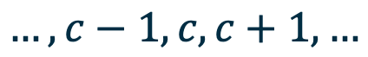
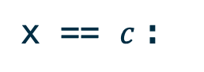

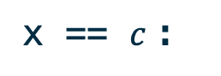
How did we achieve it?
We rewrite reads/writes to abstracted arrays.
$$…,c−1,c,c+1,…$$
array:
x != $c$:
We don’t care! Just return an arbitrary value!
Read a[x]
x == $c$:
Return a[x].
x != $c$:
We don’t care! Do nothing!
Write a[x]
x == $c$:
Write value to a[x].
Notes:
Say we have this array that we want to abstract. c is the location that we want to handle precisely and every other locations should be abstracted.
Intuitively, we don’t care about other locations and we don’t want to keep the values storing in them. This can be done by rewriting the accesses to this array.
If in the program, we read an entry from the array, we first check whether it’s at index c. If not, we didn’t track the value in this location and just return an arbitrary value to preserve the original behavior of this read. On the other hand, If it is at c, we just return the precisely tracked value at this location.
When we write something to a location, we also need to check whether the location is precise. If it is not, we don’t need to keep track of the value and we can discard it. If it is at the precise location, we write the value to the location.

Slide 14


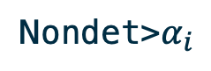
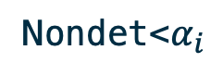

How did we achieve it?
We rewrite iterators used in loops.
We keep this iterator in the abstract index space instead:
When we use (read) an abstracted iterator:
When we update an abstracted iterator:
array:
Concrete index space:
$$0, …,c−1,c,c+1,…, n−1$$
Abstract index space:
$$0 1 2$$
i => i$abst
Nondet<$α_{i}$
i$abst==0
i$abst=>concretize(i$abst)=
$$c$$
i$abst==1
Nondet>$α_{i}$
i$abst==2
0 or 1
i$abst==0
i=i+1=>i$abst=
$$2$$
i$abst==1
2
i$abst==2
Notes:
Similar things can be done for loops over such arrays. Those loops often has an iterator that goes through the index space of the array. If we want to abstract the loop, we want to precisely handle some of the indices and abstract others away. In this example, c is the only location we want to precisely handle. Then all indices are mapped to 0, 1, and 2, representing locations before c, c itself, and locations after c.
Originally we have an iterator running in the concrete index space, and now we will have an abstracted iterator that runs in the abstract index space 0, 1 and 2.
Then inside the loop, when we read this iterator, we need to map it back to the concrete index space. In this example, we map 0 to an arbitrary value smaller than c, we map 1 to c and 2 to an arbitrary value greater than c.
We also need to rewrite the instructions that update the iterator. For example, when increase I by 1, the abstracted iterator will have some non-deterministic behavior. From 0, it can either stay at 0, or go in to location 1. From the abstract index 1, which is c, after the increase, it can only go to location 2. When it is at the abstract index 2, it can only stay at 2. In this way, we abstract the behaviors of loops over arrays that we want to abstract.

Slide 15
How did we achieve it?
Our tool (RRA)
GOTO program
Abstracted
GOTO program
The tool goes through the program and rewrites loops/array accesses.
Large loops and arrays are now handled with a small abstracted model.
CBMC can check the output program unboundedly
Notes:
Now we know how to abstract array accesses and loops. The tool we implemented actually goes through every instructions of the program to rewrite behaviors of array accesses and loops in the way we mentioned. It works at GOTO program level and takes a GOTO program as an input, while outputs the abstracted version.
In the abstracted GOTO program, large loops and arrays are now handled with a small abstracted model that can be checked by CBMC. The proof of the abstracted GOTO program implies the unbounded proof of the original GOTO program.

Slide 16
A few questions
Is it general?
Is it sound?
Notes:
This all sounds good, but now we may want to talk about two questions. Is it general and is it sound.

Slide 17
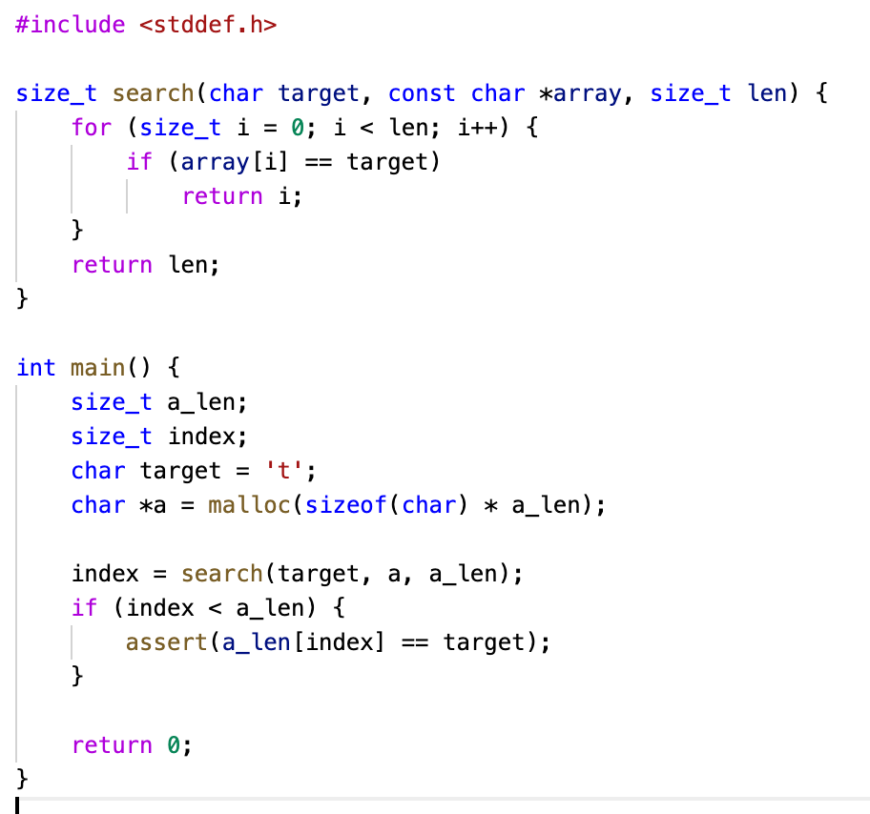



Is it general?
The prototype implemented in my last year’s internship is not general.
Look at variable names at static time to determine which one should be abstracted
Heavily relied on some ad-hoc rules
“a” should be abstracted
char *a = malloc(a_len); // should be abstracted
char *b = malloc(b_len); // shouldn't be abstracted
char *c = a;
“c” should be abstracted, because
An ad-hoc rule we relied on:
“If we assign an abstracted array to another, the other should also be abstracted”
Notes:
First, let’s talk about whether it is general. You may want to ask whether it is a toy or whether it is a tool that can handle general C programs we use in our daily life. A naïve way to achieve what we just talked about is to use a static analysis tool to carefully read our program and re-write instructions.
In my last year’s internship, I implemented a prototype of RRA that exactly did this. It looked at variable names at static time, searched for their usage in the program and determined whether the variable should be abstracted. This was definitely not general because it heavily relied on some ad-hoc rules.
I’ll provide an example on one ad-hoc rule we used last year. If the user tells us the array “a” should be abstracted and we have the following program.
Last year’s prototype will know that c should also be abstracted in the same way as array a because of the following adhoc rule: if we assign an abstracted array to another, the other should also be abstracted.

Slide 18
Is it general?
The prototype implemented in my last year’s internship is not general.
Look at variable names at static time to determine which one should be abstracted
Heavily relied on some ad-hoc rules
“a” should be abstracted
char *a = malloc(a_len); // should be abstracted
char *b = malloc(b_len); // shouldn't be abstracted
char *c = nondet() ? a : b;
???
Behaviors undefined in our ad-hoc rules
This was not general!
Notes:
This was not general because no matter how carefully we defined those ad-hoc rules, there could always be some undefined behaviors. For example, what if array c is assigned in a non-deterministic way. In this case whether it should be abstracted can only be determined at run-time. There’s no way static rules can handle it. The best we could say was it didn’t support this program.

Slide 19
Is it general?
Memory
Abstracted memory objects
Identify (arrays/indices) that should be abstracted statically
(name-based)
Handle abstraction at a lower layer
(address-based)
2020 implementation
2021 implementation
Notes:
This year, we completely re-wrote the implementation to move to a more general approach. Instead of the name-based abstraction, we now handle abstraction at a lower layer, and we call it address-based.

Slide 20
Is it general?
Memory
Statically determine which variables are for abstracted arrays
Dynamically track all abstracted memory objects
Only need to re-write low-level memory accesses:
*exp
Quite general, but still not universal
E.g. Loop dependences not supported
Abstracted memory objects
Notes:
In this implementation, instead of trying to decide how to do abstraction at static time, we move the information to run-time. At run time, we keep track of information for all allocated memory objects. Some of them should be abstracted and others should not.
To achieve behavior of abstraction, we only need to re-write low-level memory accesses, which is the dereference expressions in GOTO programs. When we access a memory location, we will dynamically check whether it is within an abstracted array. In such way, we no longer need to rely on a set of static rules and our tool becomes much more general.
However, moving this decision procedure to run-time does have some issues. Performance issue is a big one since all of them will appear in the formula checked by SAT solver. In this year we also spent a lot of time solving performance issues for the address-based approach, but we don’t have time to talk about it during this talk.
This is quite general, but it still has some limitations. For example, in loops we abstract, we still don’t allow loop dependences between iterations.

Slide 21
A few questions
Is it general?
Is it sound?
Notes:
The next question is whether our tool is sound.

Slide 22


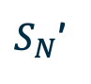

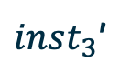
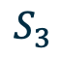
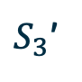
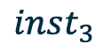
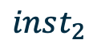
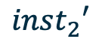
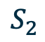
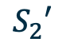

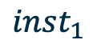
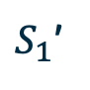
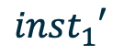


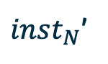
Is it sound?
Can we trust the result?
Abstracted program proved correct => original program correct?
Soundness of abstraction:
Every failure trace in the original program could also happen in the abstracted program
$$inst_{1}$$
$$inst_{2}$$
$$inst_{3}$$
$$inst_{N}$$
$$S_{1}$$
$$S_{2}$$
$$S_{3}$$
…
$$S_{N}$$
$$FAIL$$
Original program
$S_{1}$’
$$S_{2}′$$
$S_{3}$’
…
$S_{N}$’
$$FAIL$$
$$inst_{1}′$$
$$inst_{2}′$$
$inst_{3}$’
$inst_{N}$’
Abstracted program
Notes:
Soundness means that, If the abstracted program is proved correct, we can say the original program is correct.
We can say this in another way. We want to make sure that if we have a failure trace in the original program, that trace must also be possible in the abstracted program. During this year’s internship, we formally proved that RRA is sound.

Slide 23
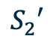
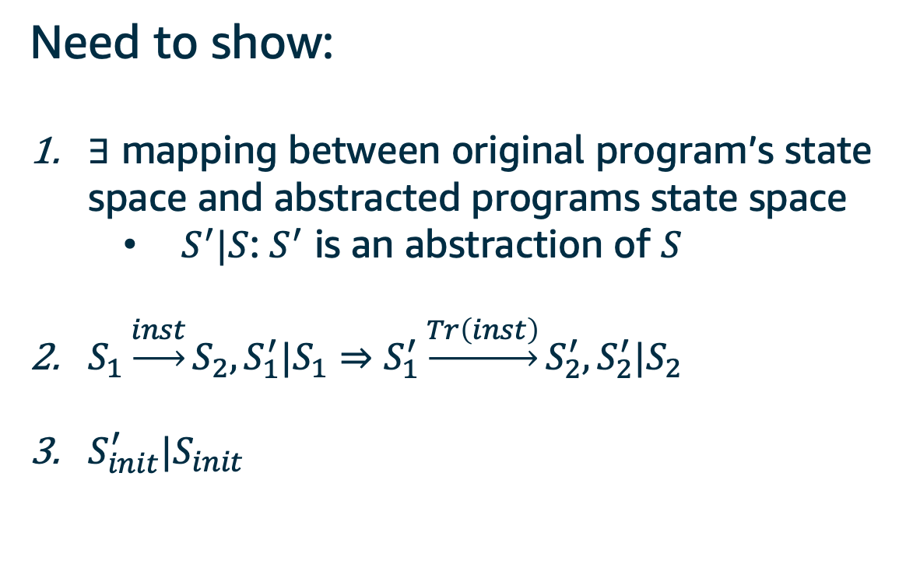
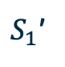
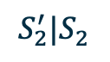
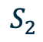
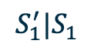

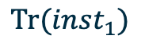

Is it sound?
Proving soundness of abstraction is similar to proving correctness of a compiler
Show: There exists a refinement mapping
Need to show:
$∃$ mapping between original program’s state space and abstracted programs state space
$S^{′}|S$: $S^{′}$ is an abstraction of $S$
$S_{1}\underset{→}{inst}S_{2},S_{1}^{′}|S_{1}⇒S_{1}^{′}\underset{→}{Tr\left(inst\right)}S_{2}^{′},S_{2}^{′}|S_{2}$
$S_{init}^{′}|S_{init}$
$S_{1}$’
$$S_{2}′$$
$$Tr(inst_{1})$$
Abstracted program
$$S_{1}^{′}|S_{1}$$
$$S_{2}^{′}|S_{2}$$
$$S_{1}$$
$$inst_{1}$$
$$S_{2}$$
Original program
Notes:
Proving soundness of abstraction is very similar to proving correctness of a compiler. Both of them re-writes a program and wish to preserve behaviors.
We want to show that there exists a refinement mapping.
To do so, first, we want to show there’s a mapping between the original program’s state space and the abstracted program’s state space. We call this relation: abstraction. We write a vertical bar to say S prime is an abstraction of S.
Second, we want to show transitions in the original program are preserved. Say we have a transition in the original program between S1 and S2 because of an instruction, and we also have that S1 prime is an abstraction of S1. Then going from S1 prime, there will be a transition in the abstracted program to S2 prime, where S2 prime is an abstraction of S2.
Third, we need to show the initial state of the abstracted program is an abstraction of the initial state of the original program. After showing those three, we will be able to construct a failure trace in the abstracted program that corresponds to a failure trace in the original program.

Slide 24
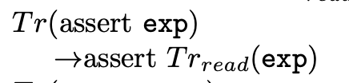
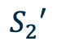

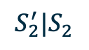
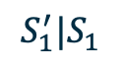

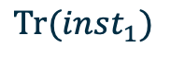


Is it sound?
Formally define:
Semantics of the original program model
Semantics of the abstracted program model
Transformation
Example: semantics for original programs
$S_{1}$’
$$S_{2}′$$
$$Tr(inst_{1})$$
Abstracted program
Example: semantics for abstracted programs
$$S_{1}^{′}|S_{1}$$
$$S_{2}^{′}|S_{2}$$
$$S_{1}$$
$$inst_{1}$$
$$S_{2}$$
Original program
Example: abstract transformation
Notes:
We won’t go into too many details of our soundness proof. Here I’ll just briefly mention a couple things we did for this.
We formally defined operational semantics of both the original program and the abstracted program. The example is just to show what it looks like. You don't need to really look into it.
Then we formally defined the transformation between the original program and the abstracted program.

Slide 25
Is it sound?
We have a formal proof on existence of refinement mapping.
Mechanization of our proof (on-going)
Chris Chak (intern @ARG) has defined GOTO semantics in Coq
Part of soundness proof has been checked with Coq
Example: refinement mapping for assignment to memories (partial)
Notes:
With all those semantics and transformation formally defined, we are able to prove that there exists a refinement mapping. Again, this is just to show what it looks like.
We are also working on mechanizing our proofs. Chris Chak has defined semantics for GOTO programs in Coq. Those semantics are really similar to semantics I defined in the soundness proof. So similar that I can re-use those to mechanize my proof in Coq. Now it is still on-going and part of the soundness proof has been checked with Coq.

Slide 26
Evaluation of our tool (RRA)
Notes:
Okay now we know RRA is sound. Our next thing would be evaluating our tool with some benchmarks.

Slide 27
Evaluation of our tool (RRA)
RRA works best on loops over indexed arrays
Target: AWS-C-Common
Arrays
Array Lists
Byte Buffers
Byte Cursors
Hash Tables
Linked Lists
Priority Queues
Ring Buffers
Strings
112 functions in total
61 functions have loops over arrays (LOAs)
Not indexed arrays
Those are bounded proofs before!
Notes:
RRA works on loops over indexed arrays. AWS-C-Common, which is a C package used in Amazon has a lot of functions related to array-like data structures.
Those are the data structures that show up in AWS-C-Common. After getting rid of ones that is not array-like, we have those remaining, and there are 112 functions related to them.
We applied our tool to the remaining functions and more than half of them can be proved with RRA.
Of all the 112 remaining functions, 61 of them have loops over arrays.
After applying RRA, 36 of the 61 are proved unboundedly. This is about 60 percent. Note that those proofs were all bounded before we applied RRA.

Slide 28
Evaluation of our tool (RRA)
RRA works best on loops over indexed arrays
Target: AWS-C-Common
Arrays
Array Lists
Byte Buffers
Byte Cursors
Hash Tables
Linked Lists
Priority Queues
Ring Buffers
Strings
112 functions in total
61 functions have loops over arrays
15 proved (last year) =>
~60 proved (this year)
Not indexed arrays
Those are bounded proofs before!
Notes:
As a comparison, last year we only proved 15 programs in AWS-C-Common and now on the same package we proved around 60. This shows how general our tool has become.

Slide 29
Recap
Implemented address-based replication reducing abstraction (RRA)
Toy prototype (2020) => More general tool
Proved soundness of abstraction
Applied our tool to AWS-C-Common and proved 61 functions unboundedly
Acknowledgement
Thanks to
Mike Whalen and Mark Tuttle
Chris Chak
Rustan Leino
https://w.amazon.com/bin/view/ARG/ProofPlatformsTeam/Abstraction/
Notes:
In summary, in this summer I implemented tool that provided unbounded proofs by using abstraction. It is way more general than the toy prototype I made in my last year’s internship.
I also gave a formal proof that our tool, RRA is sound.
We applied our tool to proofs related to array-like data structures in AWS-C-Common and got 61 of them unboundedly proved.
I’d like to give my thanks to my manager Mike and my mentor Mark, who gave me great support during this internship. Without them, I wouldn’t have known how to properly do a soundness proof. I’d like to thank Chris Chak who offered a lot of help in mechanizing the soundness proof in Coq. I also want to thank Rustan Leino for help on doing the soundness proof in Dafny. I was using Coq because we could reuse Chris’s GOTO semantics and get something out really quickly, but after talking with Rustan, I realized the soundness proof can actually be checked more easily with Dafny. Lots of details manually done by Coq would be handled automatically with Dafny. The help from him was extremely clear and useful, and we'll definitely look at that direction.
We also have a wiki page available if you want to read more details about this project.

Slide 30
Q&A
Lefan Zhang (lefanz@)
https://w.amazon.com/bin/view/ARG/ProofPlatformsTeam/Abstraction/
Notes:
Thanks for coming to my end-of-internship talk, and I’m happy to take questions.

Slide 31
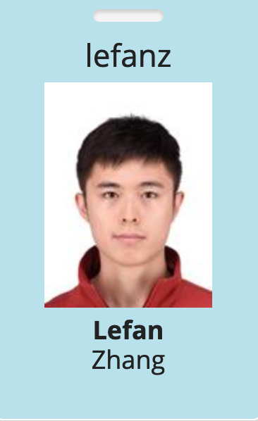
About myself
(Almost) 5th year PhD student at the University of Chicago
Research:
Intersection between formal method and HCI;
Provide better programming experience for end-users of smart-homes
At Amazon:
Applied scientist intern @ ARG group
Manager: Mike Whalen (mww@)
Mentor: Mark Tuttle (mrtuttle@)

Slide 32
Intuition of replication reducing abstraction (RRA)
Goal: Unbounded proofs
We want unbounded proofs: programs are correct for any size input data
CBMC does not “out of the box” support unbounded proofs.
Loops must be bounded
This means CBMC may miss errors that occur only in “large” inputs.
Two approaches to allow unbounded proofs in CBMC
Loop invariants
Code abstractions
This Talk!

Slide 33
Table of contents
Intuition of replication reducing abstraction (RRA)
Our tool (from users’ perspective)
Demo
How did we achieve it?
A few questions:
Is our tool general?
Is our tool sound?
Evaluation of our tool (RRA)
Notes:
First few minutes are really important. Punchline: I’ve solved xxxx that can xxxx

Slide 34

Intuition of replication reducing abstraction (RRA)
$${…, α}_{i}−1,α_{i},α_{i}+1,…$$
for (size_t i=0; i<n; i++) {
assert(P(a[i]));
}
array:
iteration:
…
…
Assertion failure
i | 0 | 1 | 2 | 3 | 4 | 5 | 6 | 7 | 8 | 9 | 10
a[i] | 5 | 7 | 3 | 13 | 4 | 101 | 3 | 4 | 75 | 63 | 2
i | 0 | 1 | 2 | 3 | 4 | 5 | 6 | 7 | 8 | 9 | 10
a[i] | 5 | 7 | 3 | 13 | 4 | 101 | 3 | 4 | 75 | 63 | 2

Slide 35

Our tool (from users’ perspective)
goto-cc
Our tool (RRA)
CBMC backend
C program/proof
GOTO program
Abstracted
GOTO program
JSON abstraction info
$${…, α}_{i}−1,α_{i},α_{i}+1,…$$
array:
iteration:
…
…
We developed a tool that automatically rewrites a program to abstract loops and arrays.
array:
iteration:

